Slide 1
Module 4 PART B: Virtual memory systems
Dr. Venkatraman S.
Associate Professor, SCOPE, VIT Chennai.

Slide 2
Overview:
Virtual memory systems
Translation Lookaside Buffer (TLB)
Memory system reliability in terms of error correction and error detection.

Slide 3
Virtual memory systems
The primary memory can turn as a “cache” for the hard disk /external storage. This practice is termed as “virtual memory”.
(Note: Active portions of a software resides in primary memory but cache contains frequent or active data of a running program. )
Virtual memory serves in two ways. Firstly, it helps one to expand the usage of physical memory by disk usage. Second , it helps us to preserve memory, since every virtual address is converted into a physical address.
Most design decisions are influenced by the high cost of a page fault in virtual memory systems. It will take millions of clock cycles to transfer a page fault to disk.

Slide 4
Basic Terms
Page Frames or Frames:
Main memory is divided into fixed size of small blocks.
Pages:
Logical memory is divided into small and same size of blocks.
Swap Space:
The virtual machine usually creates the space on flash memory or disk for all the pages of a process when it creates the process. This space is called the swap space.

Slide 5
Demand Paging Method
In the demand paging method, where processes are stored in secondary memory, and pages are loaded on demand only, not before.
When a context switch happens, after loading the first page, the computer system starts running the new program and fetches the pages of that program as they are referenced.
Advantages:
Minimum I/O operations.
Minimum Memory required.
Quick response.
Allow more user programs.

Slide 6
Basic Terms (Continued…)
Dirty bit:
To track whether a page has been written since it was read into the memory, a dirty bit is added to the page table. The dirty bit is set when any word in a page is written. If the operating system chooses to replace the page, the dirty bit indicates whether the page needs to be written out before its location in memory can begiven to another page. Hence, a modified page is often called a dirty page.
Valid bit:
If the valid bit is on, the page table supplies the physical page number (i.e., the starting address of the page in memory) corresponding to the virtual page. If the valid bit is off , the page currently resides only on disk, at a specified disk address..

Slide 7
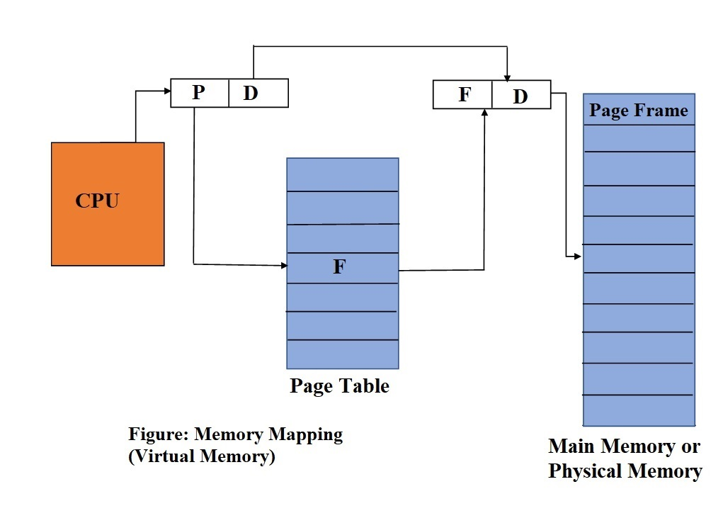
Virtual Memory Mapping

Slide 8
Memory Mapping
Logical Address
Physical Address
Physical Memory
CPU
P
D
F
D
F
Page Table
v
d
P
F

Slide 9
Memory Mapping (Continued…)
CPU generated logical address, which consist of a page number “p” and a page offset “d”.
Page table contains page number (is act as an index) and page frame number.
Physical address is generated by combining page frame number “f” with page offset “d”.
If logical address is m bits and page size is 2^n words then the logical address space is 2^m and (m-n) bits are assigned to page number.

Slide 10
Assignment: 1
1) If virtual address is 32 bits and size of page is 4kB then find how many bits are required to define page number and page offset?
2) If a computer hardware has a page with 4096 bytes and a process required 73,655 bytes then find the number of frames need to store the process in memory?
3) If a computer system has a 48-bits logical address, 8 bytes page table entry and 4 kB pages, then find the size of page table.

Slide 11
Solution for Assignment 1:
Solution 1):
Number of bit for Logical address =32, Page size = 4KB= 4*2^10=2^12 i.e number bits for page offset is =12, therefore number of bits for page number = 32 – 12=20 bits.
Solution 2):
Process required 73,655 bytes, page size= 4096 bytes therefore number of frames needed =73655/4096 = 18.
Solution 3):
Logical address = 48 bits , page size= 4KB= 2^12, i.e, 12 bits for page offset, and number of bits for page number = 48 -12=30 bits therefore the size of page table = 2^30 *8=2^33.

Slide 12
Drawback:
If page table is very large then implementation of fast registers for most modern computers are not feasible.
With the use of Page Table Base Register (PTBR), we can reduce context switching time. Since this scheme needs 2 memory accesses, to overcome this issue a speedy lookup cache called Translation Lookaside Buffer (TLB) was proposed.

Slide 13
Translation Lookaside Buffer (TLB)
A translation lookaside buffer (TLB) is a cache that stores latest translations of physical addresses to logical memory for quicker retrieval.
Each row of TLB consists of a tag and a value.
When the associative memory can be obtained with an item, all the tags match the item at the same time.
When the element is located it returns the corresponding value field. The search is quick; however, the hardware is expensive..

Slide 14
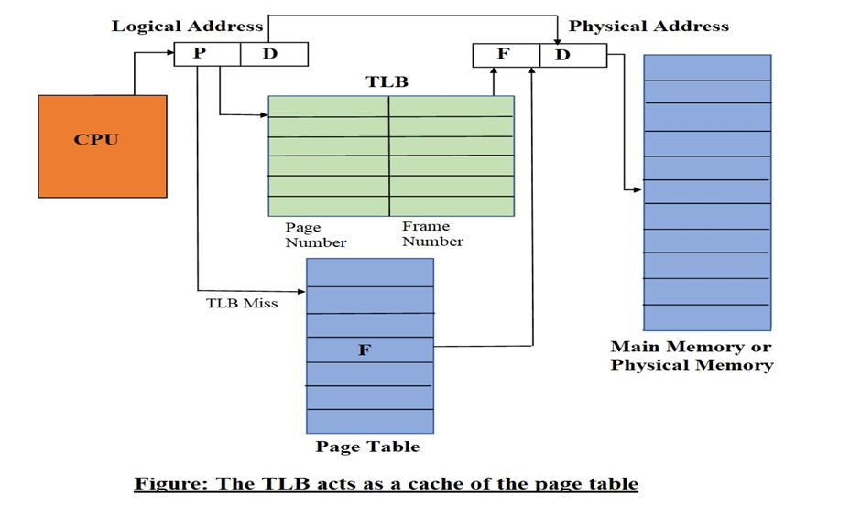
Memory Mapping with TLB

Slide 15
Memory Mapping along with TLB
Logical Address
Physical Address
Physical Memory
CPU
P
D
F
D
TLB
F
v
d
P
F
TLB Miss
v
d
P
F
Page Table

Slide 16
Assignment: 2
If the TLB hit ratio is 0.6, 60 msec to access main memory and 30 msec to search the TLB then find the effective access time ?
In a paging system, the translation Look-a-side Buffer (TLB) hit ratio is 50%, it takes 40 ns to search TLB and 120 ns to access the main memory. Compute effective memory access time?
3) A TLB-access takes 15 ns, hit ratio is 92% and physical memory access takes 45 ns. What is the effective memory access time?

Slide 17
Assignment: 2 - Solutions
If the TLB hit ratio is 0.6, 60 msec to access main memory and 30 msec to search the TLB then find the effective access time ?
Ans:
Effective Memory access (EMA)
= 0.6 * (30 +60) ms + 0.4 *(30+ 60+ 60) ms
EMA = 54 ms + 60 ms = 114 ms .
In a paging system, the translation Look-a-side Buffer (TLB) hit ratio is 50%, it takes 40 ns to search TLB and 120 ns to access the main memory. Compute effective memory access time?
Ans:
EMA = .5 *(40 +120) + .5 *(40+120+120) ns = 80 + 140 = 220 ns.
A TLB-access takes 15 ns, hit ratio is 92% and physical memory access takes 45 ns. What is the effective memory access time?
Ans:
EMA = .92 *(15 + 45) + .08 * (15 +45 +45)ns = 55.2 + 8.4 = 63.6ns.

Slide 18
Reliability of Memory Systems:
Error :
It is a state when the output data does not match with the input data.
A computer memory system is a matter to errors. These can be characterized as soft errors and hard failures.
A soft error is a non-destructive, random occasion that modifies the contents of one or more memory cells.
A hard failure is a fault within the disks, tapes or electronic circuits of a computer system.

Slide 19
Reliability of Memory Systems: Continued…
Error Detecting Systems:
It is the process of encountering errors, resulting from operational deficiencies or noise.
Error Detecting Code (EDC):
A code that is considered to detect an error in data,

Slide 20
Reliability of Memory Systems: Continued…
Error Correcting Systems:
It is the process of discovery of errors, as well as the restoration of the original data.
Error Correction Code:
If any error occurs, then code is used to detect and correct the errors.

Slide 21
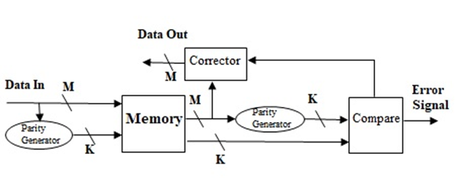
Hamming Code Architecture
The following general architecture generates a Double Error Detection (DED) and Single-Error Correcting (SEC) code for any number of bits.

Slide 22
Hamming Code Operational Procedure
Data are to be read into memory.
A function f (Parity Generator), is applied on the data to yield a code.
Parity code (K bits) and the data (M bits) are deposited in memory.
While reading out the word, a new set of K parity code bits is produced from the M data bits.
Finally, compare new parity code with old parity code bits.
Note: For M data bits or K check bits single error correction hamming code must have (2^K) - 1 >= M + K

Slide 23
Arrangement of Hamming code
Bit position | 12 | 11 | 10 | 9 | 8 | 7 | 6 | 5 | 4 | 3 | 2 | 1
Position number | 1100 | 1011 | 1010 | 1001 | 1000 | 0111 | 0110 | 0101 | 0100 | 0011 | 0010 | 0001
Data bit | D8 | D7 | D6 | D5 |  | D4 | D3 | D2 |  | D1
Parity bit |  |  |  |  | P8 |  |  |  | P4 |  | P2 | P1

Slide 24
Check (Parity) Bits Calculations
P1 = 1,3,5,7,9,11 (bit positions)
P2 = 2,3,6,7,10,11 (bit positions)
P4 = 4,5,6,7,12 (bit positions)
P8 = 8,9,10,11,12 (bit positions)

Slide 26
Example:
Generate hamming code (Even parity) for a 8-bit word – 00111001.
Bit position | 12 | 11 | 10 | 9 | 8 | 7 | 6 | 5 | 4 | 3 | 2 | 1
Hamming Code | 0 | 0 | 1 | 1 | P8 | 1 | 0 | 0 | P4 | 1 | P2 | P1
P1 = 1,0,1,1,0 = 1
P2 = 1,0,1,1,0 = 1
P4 = 0,0,1,0 = 1
P8 = 1,1,0,0 = 0

Slide 29
Example:
Detection of error using hamming code
Bit position | 12 | 11 | 10 | 9 | 8 | 7 | 6 | 5 | 4 | 3 | 2 | 1
Hamming Code | 0 | 0 | 1 | 1 | P8=0 | 1 | 0 | 0 | P4=1 | 0 | P2=1 | P1=1
P1 = P1,0,0,1,1,0 = 0/1
=>P1=1
P2 = P2,0,0,1,1,0 = 0/1
=>P2 = 1
P4= P4,0,0,1,0 = 1/1
=>P4 = 0
P8 = P8,1,1,0,0 = 0/0
=>P8 = 0
P8 P4 P2 P1
0 0 1 1
= 3
Hence error at the third bit
Correct code = 001101001111

Slide 30
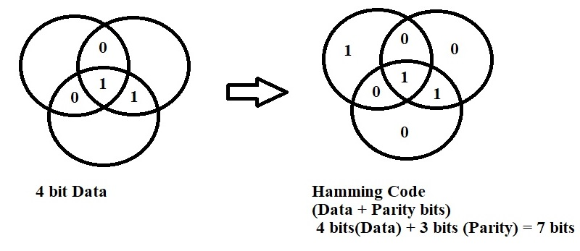
Hamming coding technique is illustrated by using Venn diagram
Hamming Encoding:

Slide 31
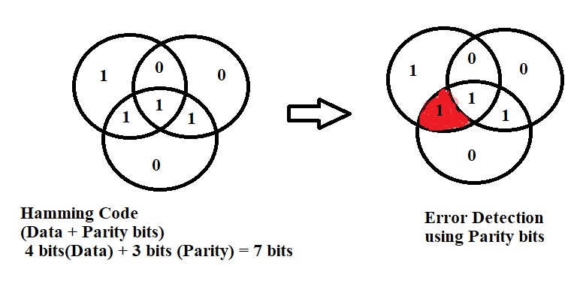
Hamming coding technique is illustrated by using Venn diagram
Error Detection:

Slide 32
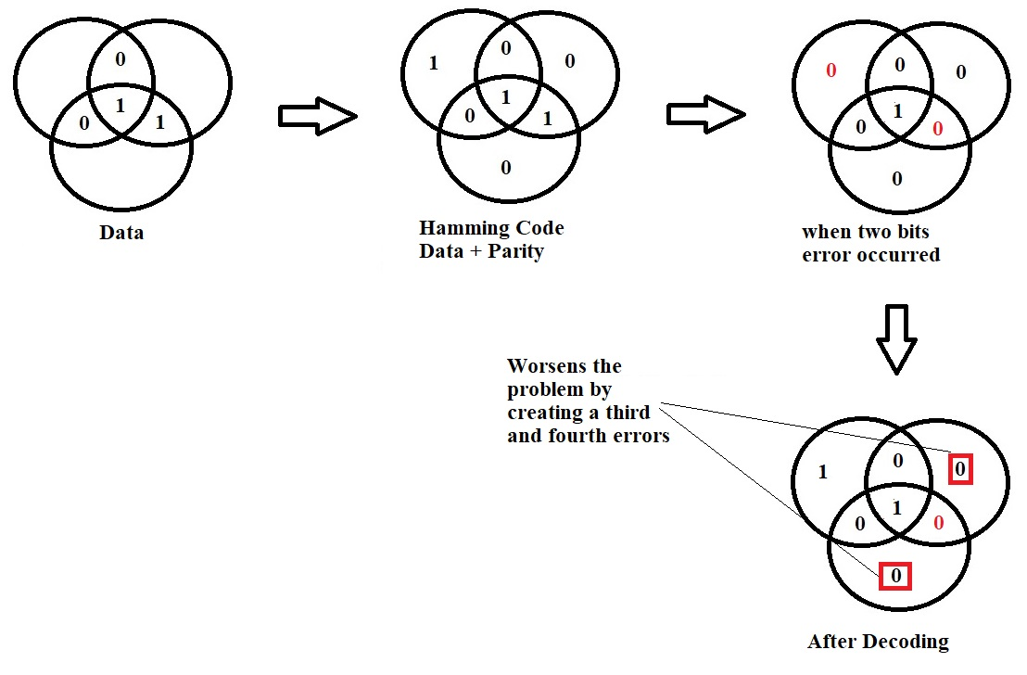
Hamming SEC-DEC Code

Slide 33
Assignment: 3
1)Find the number odd parity or check bits needed when we have 2048 bit input word?
Solution: input word = 2048 bits = 2^12 =12 bits.
2) Suppose an 8-bit input data is 11101010. Determine the odd parity or check bits?
3) Suppose an 8-bit word is 00111101, Determines the even parity bits, hamming code word and illustrate how to correct when a single bit error occurs?

Slide 34
Assignment: 3 - Solutions
1)Find the number odd parity or check bits needed when we have 2048 bit input word?
Solution: input word = 2048 bits = 2^12 =12 bits.
2) Suppose an 8-bit input data is 11101010. Determine the odd parity or check bits?
Solution:
P1 = D3⊕D5⊕D7⊕D9⊕ D11 = 0⊕1⊕1⊕0⊕1 = 0
P2 = D3⊕D6⊕D7⊕D10⊕D11 = 0⊕0⊕1⊕1⊕1 =0
P4= D5⊕D6⊕D7⊕D12 = 1⊕0⊕1⊕1 = 0
P8 = D9⊕D10⊕D11⊕D12 = 0⊕1⊕1⊕1 = 0
Bit position | 12 | 11 | 10 | 9 | 8 | 7 | 6 | 5 | 4 | 3 | 2 | 1
Hamming Code | D12 | D11 | D10 | D9 | P8 | D7 | D6 | D5 | P4 | D3 | P2 | P1
Input Data | 1 | 1 | 1 | 0 |  | 1 | 0 | 1 |  | 0

Slide 35
Assignment: 3 - Solutions (Continued..)
3) Suppose an 8-bit word is 00111101, Determines the even parity bits, hamming code word and illustrate how to correct when a single bit error occurs?
P1 = D3⊕D5⊕D7⊕D9⊕ D11 = 1⊕0⊕1⊕1⊕0 = 1
P2 = D3⊕D6⊕D7⊕D10⊕D11 = 1⊕1⊕1⊕1⊕0 =0
P4= D5⊕D6⊕D7⊕D12 = 0⊕1⊕1⊕0 = 0
P8 = D9⊕D10⊕D11⊕D12 = 1⊕1⊕0⊕0 = 0
Supposed error occurred in fifth position that is D5 got 1 instead of 0
then calculate new even parity.
P1 = D3⊕D5⊕D7⊕D9⊕ D11 = 1⊕1⊕1⊕1⊕0 = 0
P2 = D3⊕D6⊕D7⊕D10⊕D11 = 1⊕1⊕1⊕1⊕0 =0
P4= D5⊕D6⊕D7⊕D12 = 1⊕1⊕1⊕0 = 1
P8 = D9⊕D10⊕D11⊕D12 = 1⊕1⊕0⊕0 = 0
Bit position | 12 | 11 | 10 | 9 | 8 | 7 | 6 | 5 | 4 | 3 | 2 | 1
Hamming Code | D12 | D11 | D10 | D9 | P8 | D7 | D6 | D5 | P4 | D3 | P2 | P1
Input Data | 0 | 0 | 1 | 1 |  | 1 | 1 | 0 |  | 1
Syndrome word
P8 P4 P2 P1
0 0 0 1
⊕ 0 1 0 0
_____________
0 1 0 1 Error at 5th location _____________

Slide 36
Referrences:
David A. Patterson and . John L. Hennessy “Computer Organization and Design-The Hardware/Software Interface” 5th edition, Morgan Kaufmann, 2011.
Carl Hamacher, Zvonko Vranesic, Safwat Zaky, Computer organization, Mc Graw Hill, Fifth edition ,Reprint 2011.
W. Stallings, Computer organization and architecture, Prentice-Hall, 8th edition, 2009

